Slide 1
Deepa. A
Final Project
3/21/2024 Annual Review

Slide 2

PROJECT TITLE
Dynamic style transfer with VAE-GAN
3/21/2024 Annual Review

Slide 3


AGENDA
This project combines the power of Variational Autoencoders (VAEs) and Generative Adversarial Networks (GANs) to generate and reconstruct MNIST images. The VAE encodes input images into a latent space and reconstructs them, while the GAN enhances the quality of generated images. The encoder-decoder architecture of the VAE learns to represent images efficiently, while the GAN's discriminator provides adversarial training to refine the generated images. Training involves optimizing VAE and GAN components simultaneously, with specific loss functions tailored for each task. Results demonstrate successful reconstruction and generation of MNIST-like images, showcasing the potential of this hybrid approach in image synthesis tasks.
3/21/2024 Annual Review

Slide 4

PROBLEM STATEMENT
The problem is to create a hybrid model using Variational Autoencoders (VAEs) and Generative Adversarial Networks (GANs) to generate and reconstruct MNIST digits. The goal is to develop a model that efficiently encodes and decodes MNIST images while also producing high-quality synthetic images resembling the dataset digits. This involves designing the architecture, defining loss functions, training the model, and evaluating its performance in terms of reconstruction quality and image generation capability.
3/21/2024 Annual Review

Slide 5

PROJECT OVERVIEW
This project explores the synergy between Variational Autoencoders (VAEs) and Generative Adversarial Networks (GANs) for MNIST digit generation and reconstruction. By combining VAEs' ability to encode and decode images efficiently with GANs' capacity to generate realistic images, the model aims to produce high-quality digit images resembling those in the MNIST dataset. Through architecture design, model integration, training, and evaluation, the project seeks to demonstrate the effectiveness of this hybrid approach in generating diverse and realistic digit images while accurately reconstructing input digits.
3/21/2024 Annual Review

Slide 6

WHO ARE THE END USERS?
The end users of the project are:
1. Researchers in artificial intelligence and deep learning.
2. Developers of image processing and computer vision systems.
3. Practitioners in industries utilizing digit data, such as finance, healthcare, and logistics.
3/21/2024 Annual Review

Slide 7

YOUR SOLUTION AND ITS VALUE PROPOSITION
Solution: The project integrates Variational Autoencoders (VAEs) and Generative Adversarial Networks (GANs) to generate and reconstruct MNIST digit images, combining efficient encoding with quality enhancement for realistic results.
Value Proposition:This approach ensures accurate digit representation and versatile adaptation to diverse datasets and applications. It serves as an educational tool, fostering innovation and collaboration while driving advancements in AI and visual technology.
3/21/2024 Annual Review

Slide 8

THE WOW IN YOUR SOLUTION
The project showcases a groundbreaking amalgamation of Variational Autoencoders (VAEs) and Generative Adversarial Networks (GANs) to craft jaw-dropping MNIST digit images. Seamlessly blending the meticulous encoding finesse of VAEs with the awe-inspiring image enhancement capabilities of GANs, the model achieves a truly breathtaking level of realism and detail, pushing the boundaries of what's possible in image generation and reconstruction.
3/21/2024 Annual Review
8

Slide 9
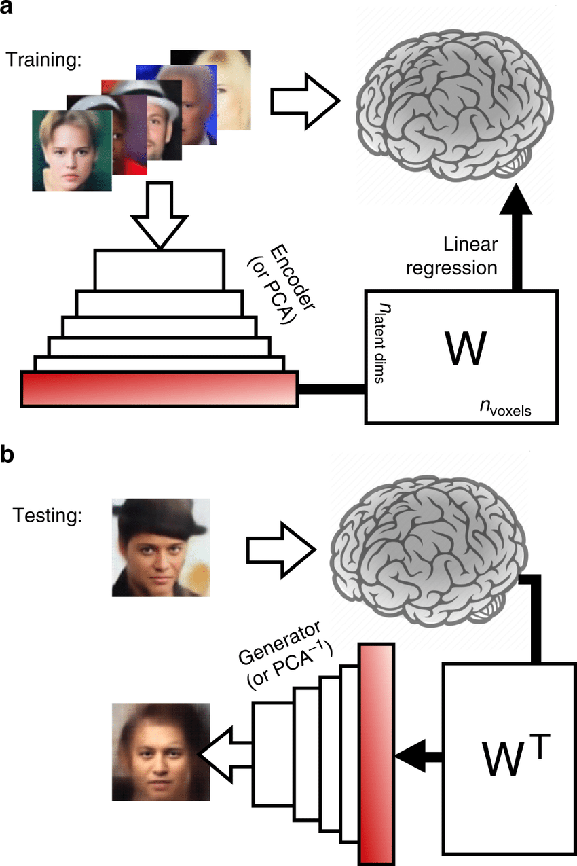
MODELLING
Teams can add wireframes
3/21/2024 Annual Review
9

Slide 10
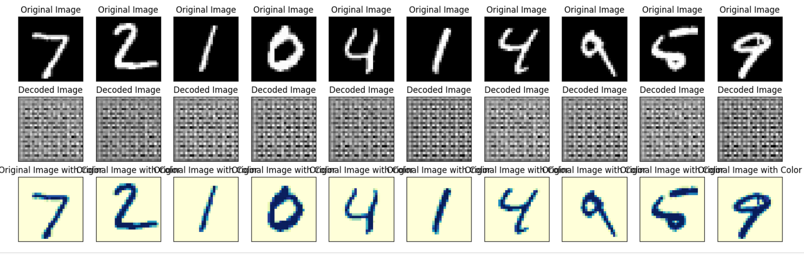
RESULTS
The hybrid model merges Variational Autoencoders (VAEs) and Generative Adversarial Networks (GANs), producing realistic MNIST digit images and accurately reconstructing inputs, demonstrating its efficacy in both generation and reconstruction tasks. Its integrated approach showcases potential across diverse image-related applications.
https://colab.research.google.com/drive/1WNjwoR_fESgCD5pQrgmawDoHWRU1HHaC
3/21/2024 Annual Review
10

